Slide 1
Computer Networks II Application Layer Web and Electronic Mail
Amitangshu Pal
Computer Science and Engineering
IIT Kanpur

Slide 2
Web and HTTP

Slide 3
Web and HTTP
Web page consists of objects
Object can be HTML file, JPEG image, Java applet, audio file,…
Web page consists of base HTML-file which includes several referenced objects
Each object is addressable by a URL, e.g.,
http://en.Wikipedia.org/somePage/pic.gif
Protocol
Server
Page on server

Slide 4


HTTP Overview
HTTP: Hypertext transfer protocol
Web’s application layer protocol
Client/server model
Client: Browser that requests, receives, (using HTTP protocol) and “displays” Web objects
Server: Web server sends (using HTTP protocol) objects in response to requests
HTTP request
PC running
Firefox browser
HTTP response
HTTP request
Server
running
Apache Web
server
HTTP response
iPhone running
Safari browser

Slide 5
HTTP Overview
Uses TCP:
Client resolves server to IP address (DNS)
Client initiates TCP connection (creates socket) to server, port 80
Server accepts TCP connection from client
HTTP messages (application-layer protocol messages) exchanged between browser (HTTP client) and Web server (HTTP server)
TCP connection closed
HTTP is “stateless”
Server maintains no information about past client requests

Slide 6
HTTP Request Message
Two types of HTTP messages: request, response
carriage return character
Request line (GET, POST,
HEAD commands)
line-feed character
GET /index.html HTTP/1.1\r\n
Host: www-net.cs.umass.edu\r\n
User-Agent: Mozilla/5.0 (Macintosh; Intel Mac OS X 10.15; rv:80.0) Gecko/20100101 Firefox/80.0 \r\n
Accept: text/html,application/xhtml+xml\r\n
Accept-Language: en-us,en;q=0.5\r\n
Accept-Encoding: gzip,deflate\r\n
Connection: keep-alive\r\n
\r\n
Header lines
Carriage return, line feed at start of line indicates end of header lines

Slide 7
HTTP Response Message
Status line (protocol
status code status phrase)
HTTP/1.1 200 OK
Date: Tue, 08 Sep 2020 00:53:20 GMT
Server: Apache/2.4.6 (CentOS) OpenSSL/1.0.2k-fips PHP/7.4.9 mod_perl/2.0.11 Perl/v5.16.3
Last-Modified: Tue, 01 Mar 2016 18:57:50 GMT
ETag: "a5b-52d015789ee9e"
Accept-Ranges: bytes
Content-Length: 2651
Content-Type: text/html; charset=UTF-8
\r\n
data data data data data ...
Header lines
Data, e.g., requested
HTML file

Slide 8
HTTP Response Status Codes
Status code appears in 1st line in server-to-client response message
Some sample codes:
200 OK
Request succeeded, requested object later in this message
301 Moved Permanently
Requested object moved, new location specified later in this message (in Location: field)
400 Bad Request
Request msg not understood by server
404 Not Found
Requested document not found on this server
505 HTTP Version Not Supported

Slide 9
Non-persistent HTTP (HTTP 1.0)
Non-persistent HTTP
At most one object sent over TCP connection
Connection then closed
Downloading multiple objects required multiple connections

Slide 10
Non-persistent HTTP (HTTP 1.0): Response Time
HTTP response time:
One RTT to initiate TCP connection
One RTT for HTTP request and first few bytes of HTTP response to return
File transmission time
Non-persistent HTTP response time =
2RTT+ file transmission time
Initiate TCP
connection
RTT
Request
file
RTT
Time to
transmit
file
File
received
time
time

Slide 11
Non-persistent HTTP (HTTP 1.0): Response Time
Non-persistent HTTP issues:
Requires 2 RTTs per object
OS overhead for each TCP connection
Browsers often open parallel TCP connections to fetch referenced objects
Initiate TCP
connection
RTT
Request
file
RTT
Time to
transmit
file
File
received
time
time

Slide 12
Non-persistent HTTP (HTTP 1.0): Response Time
We are downloading a webpage having a base HTML file with 5 embedded objects:
All objects are from the same server
The transmission time is negligible
Objects are requested sequentially
Object requests are made in parallel
Initiate TCP
connection
RTT
Request
file
RTT
Time to
transmit
file
File
received
time
time

Slide 13
Persistent HTTP (HTTP 1.1)
Persistent HTTP
Multiple objects can be sent over single TCP connection between client, server
Server leaves connection open after sending response
Subsequent HTTP messages between same client/server sent over open connection

Slide 14
Persistent HTTP (HTTP 1.1)
Persistent HTTP
Non-pipelined:
Response time of downloading a HTML file with 5 embedded objects
Pipelined: Multiple requests can be sent together

Slide 15
Non-persistent HTTP
Persistent HTTP (sequential)
Persistent HTTP (pipelined)

Slide 16
HTTP 1.1
HTTP1.1: Introduced multiple, pipelined GETs over single TCP connection
Server responds in-order (FCFS: first-come-first-served scheduling) to GET requests
With FCFS, small object may have to wait for transmission (head-of-line (HOL) blocking) behind large object(s)
Notes:
t’

Slide 17
HTTP 1.1 (HOL Blocking)
HTTP 1.1: client requests 1 large object (e.g., video file) and 3 smaller objects
Server
GET O₄
GET O₃
GET O₂
GET O₁
Object data requested
Client
O₁
O₂
O₁
O₃
O₂
O₃
O₄
O₄
Objects delivered in order requested: O₂, O₃, O₄ wait behind O₁
Notes:
t’

Slide 18
HTTP/2
Key goal: Decreased delay in multi-object HTTP requests
HTTP/2: [RFC 7540, 2015] Increased flexibility at server in sending objects to client:
Methods, status codes, most header fields unchanged from HTTP 1.1
Transmission order of requested objects based on client-specified object priority (not necessarily FCFS)
Push unrequested objects to client
Divide objects into frames, schedule frames to mitigate HOL blocking
Notes:
t’

Slide 19
HTTP/2: Mitigating HOL Blocking
HTTP/2: objects divided into frames, frame transmission interleaved
Server
GET O₄
GET O₃
GET O₂
GET O₁
Object data requested
Client
O₂
O₁
O₄
O₃
O₂
O₃
O₁
O₄
O₂, O₃, O₄ delivered quickly, O₁ slightly delayed
Notes:
shortest job first: decreased average delay!

Slide 20
Cookies
client
server
ebay 8734
usual http request msg
Amazon server
creates ID
1678 for user
cookie file
usual http response
set-cookie: 1678
backend
database
create
entry
ebay 8734
amazon 1678
usual http request msg
cookie: 1678
cookie-
specific
action
access
usual http response msg
one week later:
access
ebay 8734
amazon 1678
usual http request msg
cookie: 1678
cookie-
specific
action
usual http response msg

Slide 21
User-server State: Cookies
Many Web sites use cookies
Four components:
1) Cookie header line of HTTP response message
2) Cookie file kept on user’s host, managed by user’s browser
3) Cookie header line in next HTTP request message
4) Back-end database at Web site
Example:
An user visits specific e-commerce site for first time
When initial HTTP requests arrives at site, site creates:
Unique ID
Entry in backend database for ID

Slide 22
Cookies (continued)
What cookies can be used for:
Authorization
Shopping carts
Recommendations
User session state (Web e-mail)

Slide 23
Web Caches

Slide 24
Web caching (Browser cache + Proxy cache)
User often revisit same pages
Goal: Satisfy client request without involving origin server

Slide 25
Web caching (Browser cache + Proxy cache)
Why Web caching?
Reduce response time for client request
Reduce traffic on an institution’s access link

Slide 26
How to verify if cached content is up-to-date?
Server tells cache about object’s allowable caching in response header:
Cache-control: max-age = <seconds>
Max time until the content is considered fresh
Cache-control: public
Content is cacheable
Cache-control: private
Content is cacheable at the browser, but not at the proxy cache
Cache-control: no-cache
Cache but revalidate
Cache-control: no-store
No caching

Slide 27
Conditional GET
client
server
Goal: don’t send object if cache has up-to-date cached version
Using Last-Modified + Conditional GET
Cache: specify time of cached copy in HTTP request
If-modified-since: <time>
Server: response contains no object if cached copy is up-to-date:
HTTP/1.0 304 Not Modified
HTTP request msg
If-modified-since: <time>
object
not
modified
before
<date>
HTTP response
HTTP/1.0
304 Not Modified
HTTP request msg
If-modified-since: <time>
object
modified
after
<date>
HTTP response
HTTP/1.0 200 OK
<data>

Slide 28
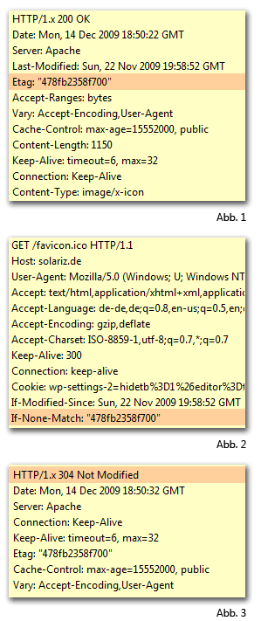
Conditional GET
Goal: don’t send object if cache has up-to-date cached version
Using ETag + Conditional GET
Cache: specify Etag (hash) of cached copy in HTTP request
If-Node-Match: <ETag>
Server: response contains no object if cached copy is up-to-date:
HTTP/1.0 304 Not Modified
Src: https://commons.wikimedia.org/wiki/File:Etag_header_beispiele.png

Slide 29
Conditional GET
Goal: don’t send object if cache has up-to-date cached version

Slide 30
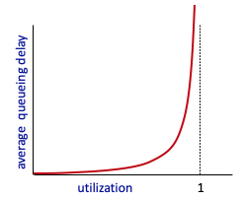

Web caching (Web Proxies)
Scenario:
Access link rate: 1.54 Mbps
RTT from institutional router to server: 2 sec
Web object size: 100K bits
Average request rate from browsers to origin servers: 15/sec
Avg data rate to browsers: 1.50 Mbps
origin
servers
public
Internet
1.54 Mbps
access link
Performance:
Access link utilization = .97
LAN utilization: .0015
End-end delay = RTT + access link delay + LAN delay
= 2 sec + minutes + usecs
institutional
network
1 Gbps LAN
Notes:
explain why minutes (recall earlier delay versus arrival rate curve from Chapter 1)

Slide 31
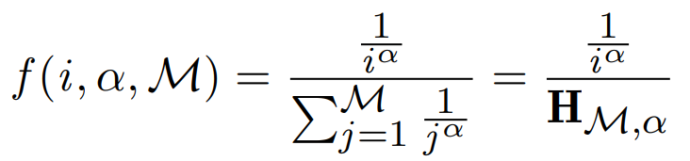
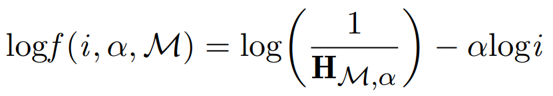
Internet Content Popularity
Zipf distribution (linear scale)
Zipf distribution (log-log scale)

Slide 32
Web caching (Web Proxies)
Suppose cache hit rate is 0.4:
40% requests served by cache, with low (msec) delay
origin
servers
public
Internet
60% requests satisfied at origin
Rate to browsers over access link
= 0.6 * 1.50 Mbps = .9 Mbps
Access link utilization = 0.9/1.54 = .58 means low (msec) queueing delay at access link
1.54 Mbps
access link
institutional
network
1 Gbps LAN
Average end-end delay:
= 0.6 * (delay from origin servers) + 0.4 * (delay when satisfied at cache) = 0.6 (2 secs) + 0.4 (~msecs) = ~ 1.2 secs
local web cache
Notes:
t’

Slide 33
Content Distribution Networks (CDNs)

Slide 34


Video Streaming and CDNs
Stream video traffic: major consumer of Internet bandwidth
Netflix, YouTube, Amazon Prime: 80% of residential ISP traffic (2020)
Challenges:
Scale - how to reach ~1B users?
Heterogeneity
Different users have different capabilities (e.g., wired versus mobile; bandwidth rich versus bandwidth poor)

Slide 35


Streaming Stored Video
Internet
Video server
(stored video)
client

Slide 36
Streaming Stored Video
Cumulative data
2. Video
sent
Video
recorded (e.g., 30 frames/sec)
3. Video received, played out at client (30 frames/sec)
Network delay
(fixed in this example)
time
Streaming: at this time, client playing out early part of video, while server still sending later part of video

Slide 37
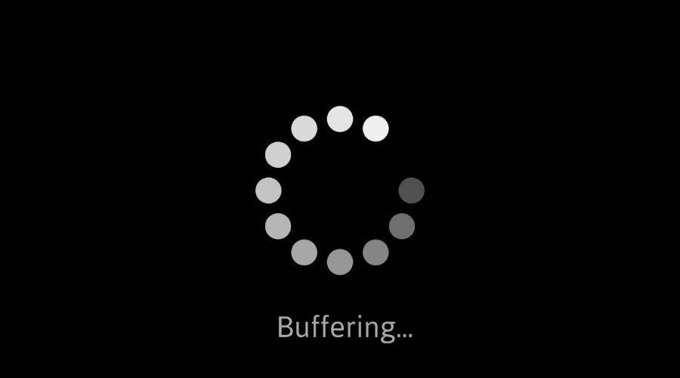
Streaming Stored Video: Challenges
Continuous playout constraint: During client video playout, playout timing must match original timing
But network delays are variable (jitter), so will need client-side buffer to match continuous playout constraint
Other challenges:
Client interactivity: pause, fast-forward, rewind, jump through video
Video packets may be lost, retransmitted

Slide 38
Streaming Stored Video: Playout Buffering
Constant bit
rate video
transmission
Client video
reception
Constant bit
rate video
playout at client
Cumulative data
Variable
network
delay
Buffered
video
Client playout
delay
time
Client-side buffering and playout delay: compensate for network-added delay, delay jitter

Slide 39

Content Distribution Networks (CDNs)
Challenge: How to stream content (selected from millions of videos) to hundreds of thousands of simultaneous users?
Solution: Store/serve multiple copies of videos at multiple geographically distributed sites (CDN)
Push CDN servers deep into many access networks
Close to users
Akamai: 240,000 servers deployed in > 120 countries (2015)

Slide 40
Content Distribution Networks (CDNs)

Slide 41
Content Distribution Networks: DNS Redirection
http://www.Netflix.com/page.html

Slide 42
Content Distribution Networks (CDNs)
Win-win solution for all parties:
Reduces server load → Content providers are 🙂
Reduces network load → ISPs are 🙂
Reduces content download time → Users/customers are 🙂

Slide 43
Electronic Mail

Slide 44
Electronic Mail
user
agent
mail
server
user
agent
User Agent
a.k.a. “mail reader”
Composing, editing, reading mail messages
Mail servers:
Mailbox contains incoming messages for user
Message queue of outgoing (to be sent) mail messages
mail
server
user
agent
user
agent
mail
server
user
agent
Outgoing
message queue
user
agent
User mailbox

Slide 45
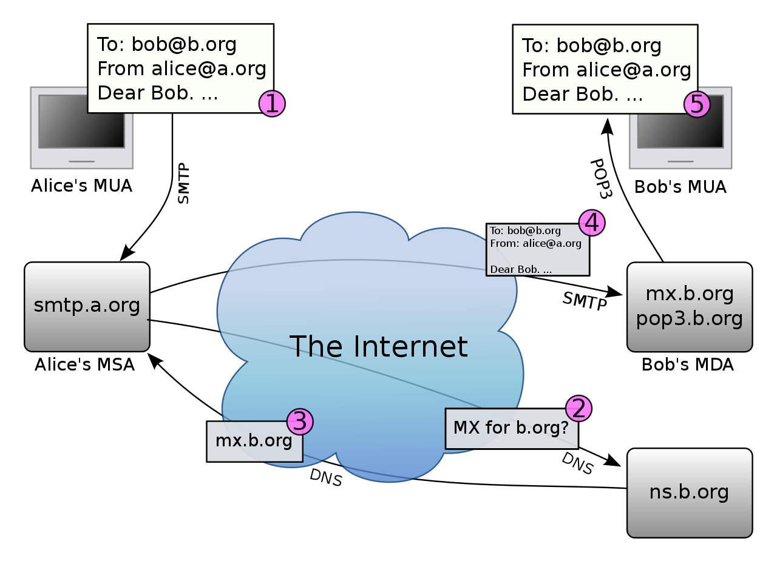
Electronic Mail
Mail transfer protocol: Delivery/storage to receiver’s server → Push operation
SMTP: Simple Mail Transfer Protocol
User agent to mail server
In between mail servers
SMTP protocol between mail servers to send email messages
Client: sending mail server
“Server”: receiving mail server
Src: https://en.wikipedia.org/wiki/Open_mail_relay#/media/File:Email.svg

Slide 46
Electronic Mail
Mail access protocol: retrieval from server → Pull operation
POP: Post Office Protocol [RFC 1939]: authorization, download
IMAP: Internet Mail Access Protocol [RFC 1730]: more features, including manipulation of stored messages on server
HTTP: gmail, Hotmail, Yahoo! Mail, etc.
Src: https://en.wikipedia.org/wiki/Open_mail_relay#/media/File:Email.svg

Slide 47
SMTP
“Client”
SMTP server
“Server”
SMTP server
Initiate TCP
connection
Uses TCP to reliably transfer email message from client (mail server initiating connection) to server, port 25
Direct transfer: sending server (acting like client) to receiving server
Three phases of transfer
SMTP handshaking (greeting)
SMTP transfer of messages
SMTP closure
RTT
220
SMTP handshaking
HELO
250 Hello
SMTP transfers

Slide 48
Summary
Web and HTTP:
Persistent and non-persistent HTTP
Web cache
Electronic mail:
SMTP, POP, IMAP

